Slide 1
PABAKE Linked Open Seas
Mentor: Prof. Andrea Giovanni Nuzzolese
Federico Battistella, Alessandro Pavesi

Slide 2
Task
Notes:
Hi professor we are here to discuss our project called PABAKE: linked open seas

Slide 3
Data
Notes:
Hi professor we are here to discuss our project called PABAKE: linked open seas

Slide 4
Reference Ontology
Notes:
Hi professor we are here to discuss our project called PABAKE: linked open seas

Slide 5
Ontology Design Pattern pt1
Notes:
Hi professor we are here to discuss our project called PABAKE: linked open seas

Slide 6
Ontology Design Pattern pt2
Notes:
Hi professor we are here to discuss our project called PABAKE: linked open seas

Slide 7
Ontology Design Pattern pt3
Notes:
Hi professor we are here to discuss our project called PABAKE: linked open seas

Slide 8
01
02
04
Competency Questions
03
05
06
How many stations are deployed in the X seas?
Or deployed in the X city?
What is the value of “parameter” for the sea X in a certain period Z?
Or for the city Y?
What sensor are already replaced by the new model?
How many/ What places are monitored?
How many sensors
are hosted on the
station X?
How many sensors
are hosted on the
station X?
Notes:
Thanks Federico, so my collegue have described the ontology and how we creted it, now lets talk about how we integrated the data and how is possible to use the ontology. First of all, following the extreme design methodology, i will show the competency questions. We created these competency questions thinking as users of our ontology, how they will queries our data to extract the main knowledge they need.
Here there are different questions that can be asked to our knowledge base, it’s possible to extract the number of stations deployed in a specific city or sea,
As well as the values of defined parameter, in a restricted area or in a defined period. Another example is the number of city covered by the linked open seas dataset or the seas, maybe these information can be used for statistical use.
As well as the model of a station, and this example is very importntant because expose an important feature of this knowledge base, the possibility to extract the history of stations deployed in the italian seas. So it is useful also for manage the replacement of these stations.

Slide 9
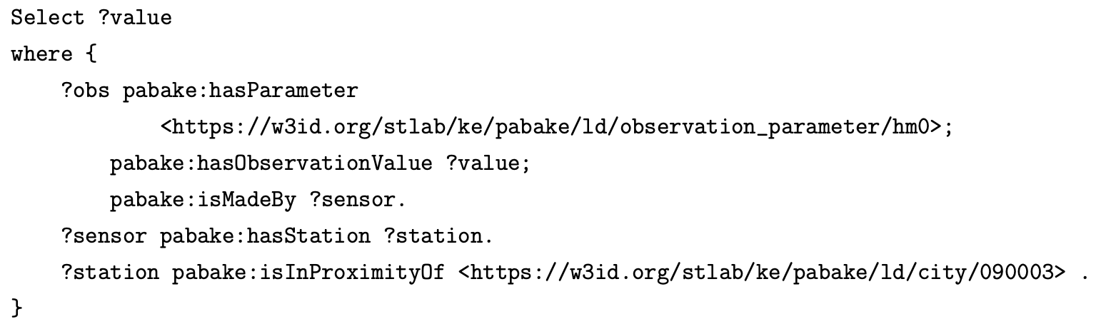
Competency Questions
This query to extract the values of a specific parameter (Hm0) for a defined city (Alghero, ISTAT code 90003)
Notes:
Thanks to our integration with Virtuoso we exposed a SPARQL endpoint that allows to explore the knowledge graph using sparql queries. Here we can see a query to extract the values of the parameter HM0 that is the height of wave for the city of Alghero that is identified by the ISTAT code.

Slide 10
Mapping Rules
PyRML: a framework for data mapping
observation.ttl: the observation template is used to create the ObservationCollection classes and the other class TimeInstant
observationsDir.ttl: manage the information about the Direction of the wave
observationsTp.ttl: manage the information about the Spectral peak wave period
observationsTm.ttl: manage the information about the Average wave period
observationsHm0.ttl: used for the information about the Significant wave height
project.ttl: contains all the other classes, including the stations, the sensors, the city or the sea
Notes:
The sparql queries extracts information from the knowldge graph based on the data we build using PyRML. To use this python package we have to build mapping files that takes as input the csv files and build triples in RDF type. The mapping is made manually based on the ontology we created before. Given the difficulty of manage the amount of data and the number of classes and relations between them we created 5 mapping files to correctly replicate the reference ontology the professor show us. We used one file for each different observable property and one file to build the ObservationCollection that connect all these single observation and other more general triples.
Therefore we map all the other data using a single file which includes the mapping for the other concepts that are relatively connected with the ObservationCollection for example the station or the cities or the seas.

Slide 11
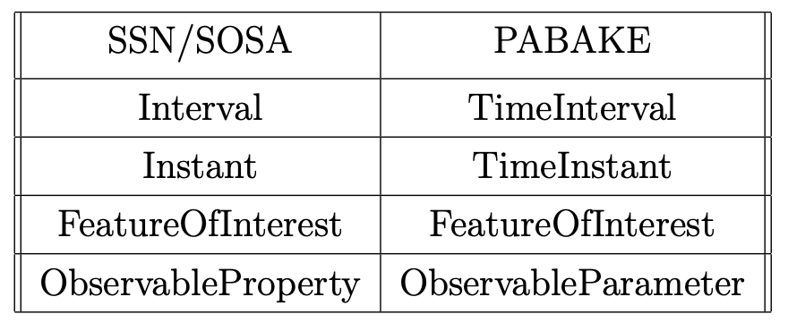
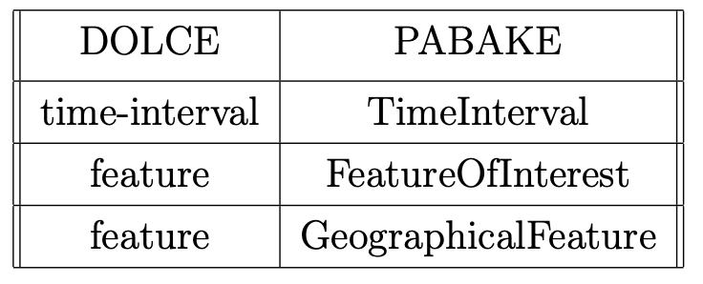
Entity Linking
Limes: is a link discovery framework for the Web of Data
DOLCE: the Descriptive Ontology for Linguistic and Cognitive Engineering is a foundational ontology
SSN/SOSA: The Semantic Sensor Network (SSN) ontology describes sensors and their observations, the methods involved, the researched aspects of interest, the samples utilized to do so, and the observed attributes, as well as actuators.
Metric used: Jaccard Index
Notes:
One of the tasks we have been asssigned is the linking with other ontologies, we decided for DOLCE and SSN/SOSA. The linking was done with LIMES a framework that is very useful to compare concepts from different ontologies. LIMES necessities to configure an XML file to build two queries with which extract the concept to compare. It is possible to use different metrics to check the similitude but according with the professor we choose the common one, the Jaccard Index.
Dolce is very abstract and conceptual so we manage to find only some part similar to our ontology. For example our concept Timeinterval is returned similar from limes to the time-interval concept of DOLCE. As well as the feature of interest and the geographical feature with the feature conceptof DOLCE.
With SSN/SOSA we have more similarities, it is a ontology used to describe sensors and their observations, as well as actuators and so on so is very similar to our purpose. We found that 4 out of 8 concepts are similar for LIMES. That are the timeintervall with interval, the time instant with instant and the concepts feature of interest that have the same name or observable property and observable parameter.

Slide 12
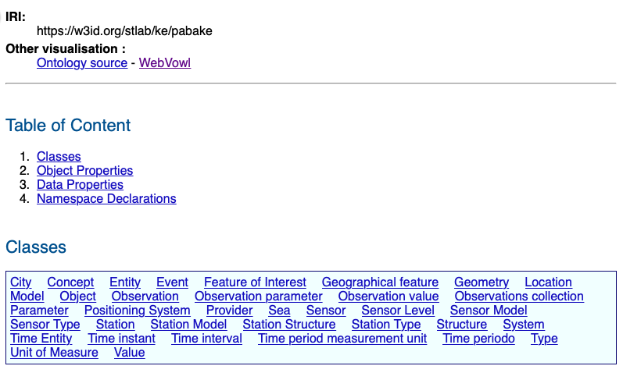
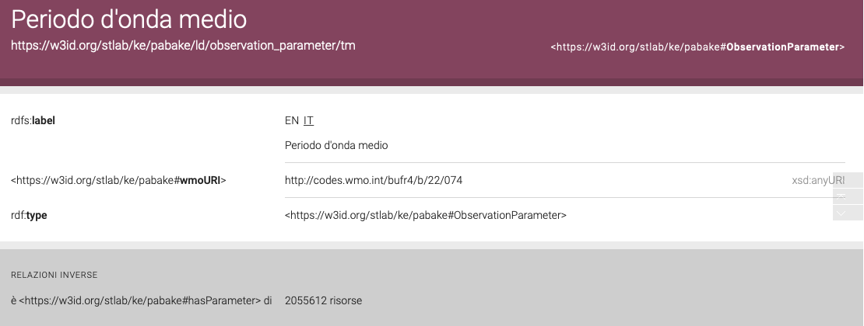
Docker
Virtuoso: SPARQL endpoint
LODE: Ontology visualization as HTML site
LODView: Visualization of instances with related information
Notes:
The docker we created contains all the RDF files loaded into virtuoso and ready to be queried. This process, given the huge amount of data took us more than a day to complete, including nearly 17 hours to complete the mapping with PYRML and almost 10 hour to load the files in virtuoso. The size of the docker becomes more than 9 gigabyte.
The other services exposed by our docker are lode and lodview.
Lode is a service to visualize the entire ontology with the instances as a html site, a very beautiful utility to have a good visualization on the data and the structure used as well as to create easily the documentation for an ontology.
LodeView instead allows to inspect single instances with information about all its connection with the other concepts as well as the description in various language. We decided for italian and english.

Slide 13
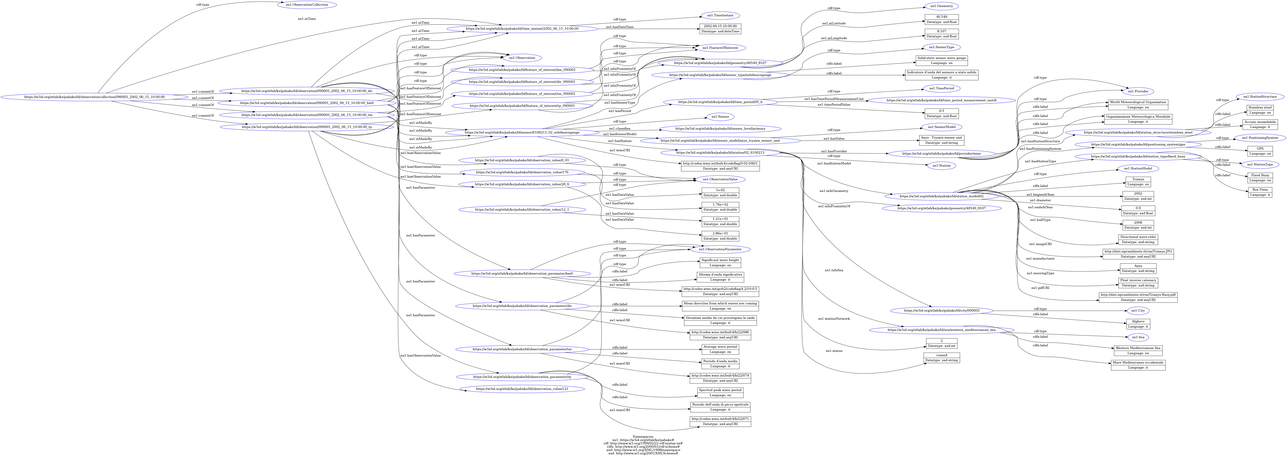
Conclusions
The ontology is publicated with the IRI: https : //w3id.org/stlab/ke/pabake#
Notes:
To conclude, we faced an hard dataset with a lot of different concepts an a huge amount of data.
we approached it using extreme design methodology that helps us to correctly defined the structure. Moreover the ontology design pattern used are very useful to keep the knowledge graph clear and readble.
So we are satisfied with the organization of the concepts as well as the creation of an ontolgy with a good depth and a project that includes all the relevant analysis, the services implementation and extensions required.

Slide 14
THANKS
Federico Battistella, Alessandro Pavesi
https://github.com/pavva94/PABAKE

